Slide 1
AAHKS Exhibitor Webinar # 1 Registration | Housing | Learning Objectives
Date: July 14, 2021 (Wednesday) Time: 12:00 p.m. – 12:30 p.m. (CDT)

Slide 2
Welcome & Introductions
Mike Zarski, Executive Director
Jeff Mitchell, Director of Marketing & Corporate Relations
Sharon Creed, Accounting & Registration Manager
Renalin Malvar-Ledda, Senior Director of Events & Operations
Lauren Miller, Tradeshow Coordinator, SmithBucklin
Heather Chapman, Senior Business Development Director, Freeman

Slide 3
2021 Exhibitor Schedule
Move-In: Wednesday, November 10
10:00 a.m. – 5:00 p.m. Move-In for 20’ x 20’ Booths & Larger Only
Thursday, November 11
10:00 a.m. – 5:00 p.m.
Show Hours: Friday, November 12
7:00 a.m. – 2:55 p.m.
6:30 p.m. – 8:00 p.m. — Welcome Reception
Saturday, November 13
7:00 a.m. – 3:30 p.m.
Move-Out: Saturday, November 13
3:30 p.m. – 10:00 p.m.
Sunday, November 14
8:00 a.m. – 11:00 a.m.

Slide 4
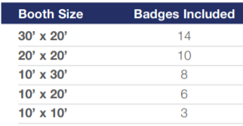
Exhibitor Registration
Registration opens week of July 12
Badge Allotments
Cost of Additional Badges
$500.00 through October 30
$600.00 starting October 31
Access to Scientific Sessions
Deadline to Register: October 31 (Exhibitor Housing: September 1)
Booth must be paid in full prior to registration.

Slide 5
Exhibitor Registration
Registration Link: https://Member.AAHKS.net/My-Exhibits
Link is e-mailed directly to primary contacts, not posted on the AAHKS website.
Representatives associated with exhibiting companies can purchase a badge online.
Sign in to your AAHKS account online by entering your username and password.
Click Manage Exhibit Reps.
Click Add Representative. A pop-up window will be displayed listing individuals already associated with your account.
(Please Note: Changes to any names, e-mail addresses, or titles can only be done by individual representatives logging into AAHKS and making changes in My Profile.
Primary contacts can only make changes to their own profile page.)

Slide 6
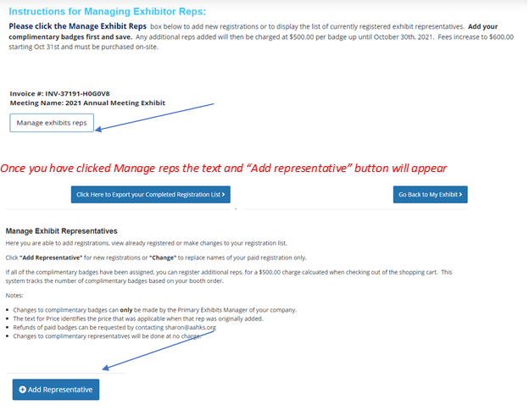
Exhibitor Registration

Slide 7
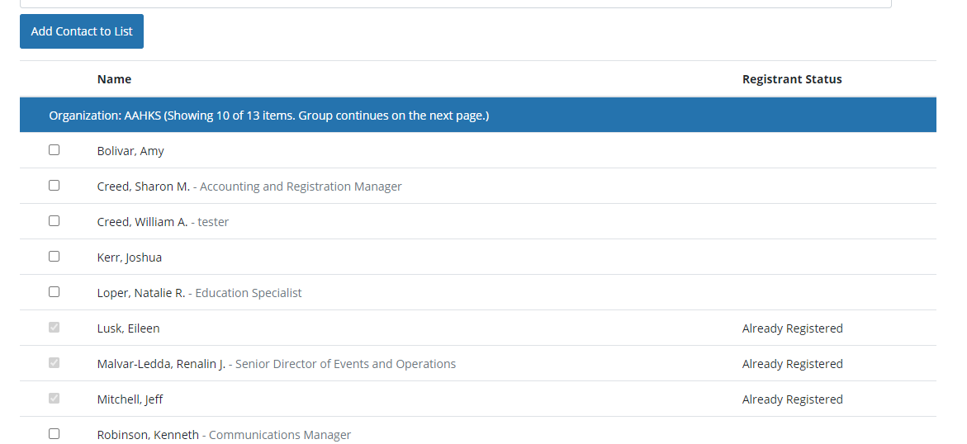
Exhibitor Registration
Check the boxes of those to be registered; if name is not shown, you can add them by selecting Add Contact to List. Once completed and you log back in, those registered will display as Already Registered. Once saved, you will be directed to a shopping cart to complete your order and pay for any badges above the complimentary allotment.

Slide 8
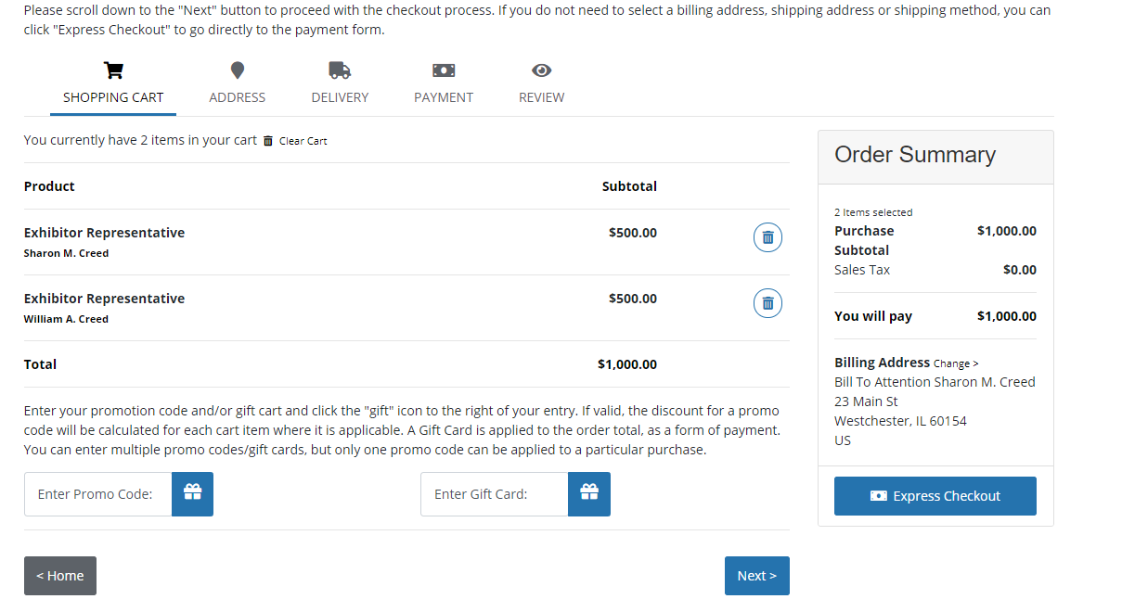
Exhibitor Registration

Slide 9
Exhibitor Registration
Add complimentary badges first, save and complete.
All representatives must have a badge for access; sharing of badges is prohibited.
You can log back in until October 31st to add additional reps or make name changes to paid reps. Refund requests must be submitted in writing to Sharon@AAHKS.org.
Badge pick-up will be on-site. Registered reps will receive individual e-mails with instructions.
AAHKS is utilizing a third-party company for badge printing and will be unable to accommodate name changes on-site. Those not registered will be required to purchase a badge on-site at the increased rate of $600.00.
*NEW* We have added a feature to allow export of your representative list for final review prior to registration close and printing your exhibit booth and badge receipts.

Slide 10
Exhibitor Housing
Exhibitor housing opens week of July 19th
Renaissance Dallas Hotel (2222 North Stemmons Freeway)
Nightly Rate: <$200.00 (plus taxes & fees)
Booking Deadline: October 8, 2021 (Friday)
Deposit Requirement: One (1) night non-refundable deposit due in order to secure room reservation

Slide 11
Customer Service Questions
Registration Questions
Contact Sharon Creed at Sharon@AAHKS.org
Housing & Logistic Questions
Contact Jeff Mitchell at JMitchell@AAHKS.org or Lauren Miller at LMiller@SmithBucklin.com

Slide 12
Learning Objectives
Timeline
Friday, July 16: Initial Submission Deadline
Friday, August 20: Final Deadline for All Revisions
How to Submit: www.AAHKS.org/Meeting
For Exhibitors > Submit Learning Objectives
Visibility
Attached to your company’s profile on the AAHKS website prior to the event
Published in the mobile app available to all attendees

Slide 13
Q & A
Thank you for attending! • Save the Date •
AAHKS Exhibitor Webinar # 2
September 15, 2021 (Wednesday)
11:00 a.m. – 11:30 a.m. (CDT)

